Slide 1
Review Chapter 8
(1)
Method of separation of variables (MSV)
(2)
Solution of wave equation
(Two versions)
(a)By MSV
where
(b) d’Alembert’s method
(3)
Solution of Heat equation
where

Slide 2
Example
Use method of S V to
solve
Solution
Let
Then
Hence
holds for any x and y

Slide 3
Therefore
for any fixed
Thus
for any fixed k
holds for any x and y
So

Slide 4
Solve the above two 1st order ODE, get
Hence

Slide 5
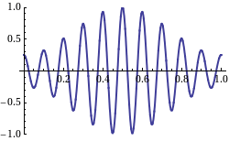
8.2 Wave Equation
Animation slide
Elastic string of length L
tightly stretched
fixed at the end points
The string is set in motion.
It vibrates in vertical plane.

Slide 6
We have
Proof omitted
where
with boundary conditions:
with initial conditions:
Initial position
Initial velocity

Slide 7
Solution of wave equation

Slide 8
Example 1
Solve the following wave equation
with boundary conditions:
with initial conditions:

Slide 9
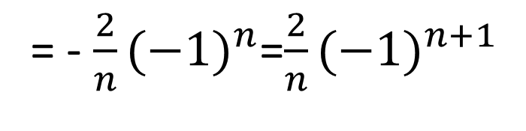
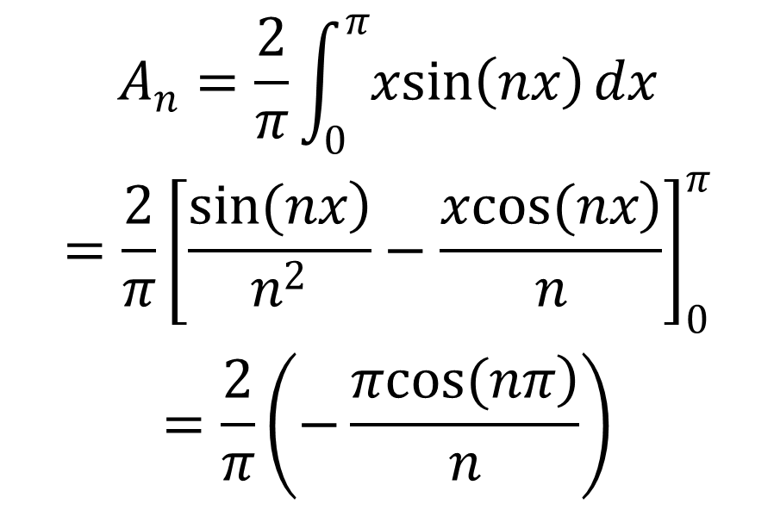
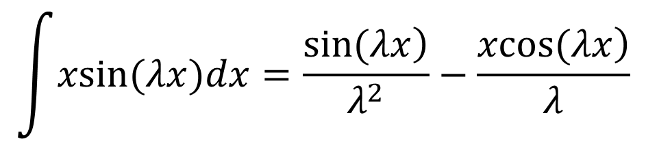
Solution
$$\int{xsin(λx)dx=\frac{\left.sin(λx\right)}{λ^{2}}}−\frac{\left.xcos(λx\right)}{λ}$$
Use formula
$$\begin{matrix}A_{n}=\frac{2}{π}\int_{0}^{π}{xsin\left(nx\right)}dx \\ =\frac{2}{π}{\left[\frac{\left.sin(nx\right)}{n^{2}}−\frac{\left.xcos(nx\right)}{n}\right]}_{0}^{π} \\ =\frac{2}{π}\left(−\frac{\left.πcos(nπ\right)}{n}\right)\end{matrix}$$
= - $\frac{2}{n}{(−1)}^{n}$=$\frac{2}{n}{(−1)}^{n+1}$

Slide 10
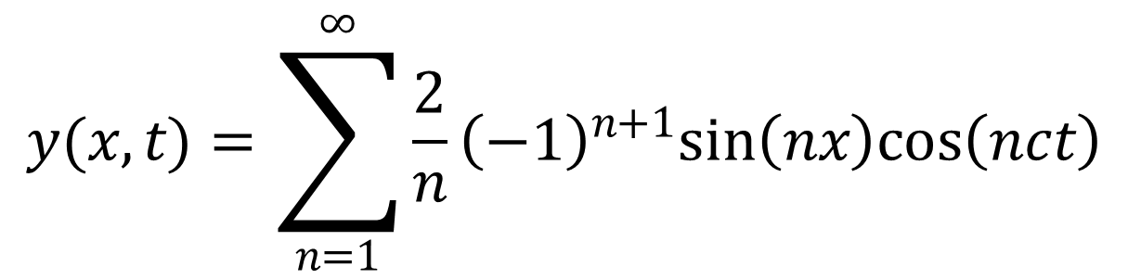
$$y(x,t)=\sum_{n=1}^{∞}{\frac{2}{n}{\left(−1\right)}^{n+1}sin\left(nx\right)cos\left(nct\right)}$$
is the solution of wave equation
with boundary conditions:
and initial conditions:

Slide 11
Example 2
Solve the following wave equation
with boundary conditions:
with initial conditions:
Solution

Slide 12
where
odd
odd
Hence
Or we can get the above result
by comparing the coefficients
See next slide

Slide 13
Hence
So

Slide 14
d’Alembert’s solution of the wave equation
with boundary conditions:
with initial conditions:
Then solution (given by d’Alembert) is

Slide 15
Revisit Example 2
Solve the following wave equation
by d’Alembert’s solution
with boundary conditions:
with initial conditions:

Slide 16
The solution (given by d’Alembert) is
In this Example 2 ,
Hence
Recall by MSV, the solution is
These two solutions are equivalent which can be proved by the following formula

Slide 17
8.3 Heat Equation
Heat-conducting rod with length L
0
L
represents temperature at point x,
at time t
Let
be thermal diffusivity
We have
Proof omitted

Slide 18
with boundary conditions:
0
0
Temperatures are always ZERO at both end points
with initial condition:
Initial distribution of temperature given by f(x)

Slide 19
Solution of Heat equation

Slide 20
Example 1
Suppose

Slide 21
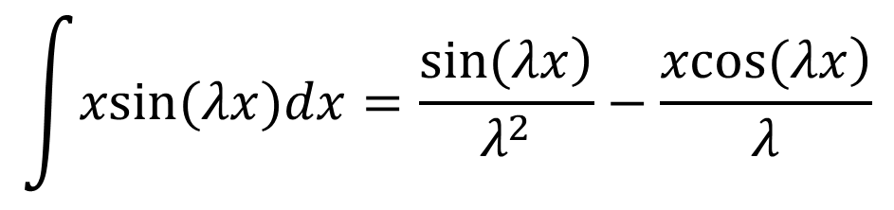
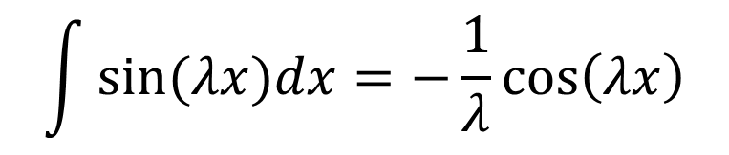
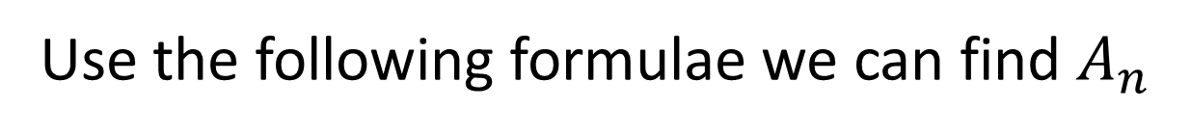
Use the following formulae we can find $A_{n}$
$$\int{xsin(λx)dx=\frac{\left.sin(λx\right)}{λ^{2}}}−\frac{\left.xcos(λx\right)}{λ}$$
$$\int{sin(λx)dx=−\frac{1}{λ}}cos\left(λx\right)$$

Slide 22




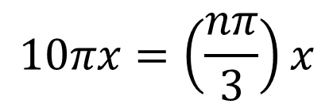
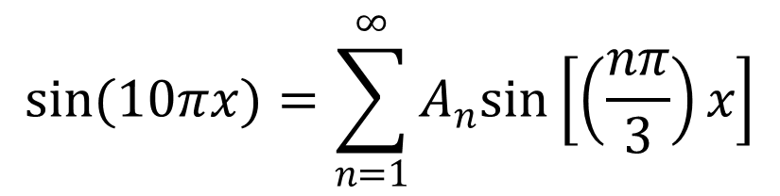
Example 2
Suppose
$$\left.L=3, f(x)=sin(10πx\right)$$
Now find
$$A_{n}$$
We shall compare coeff.
$$sin(10πx)=\sum_{n=1}^{∞}{A_{n}sin\left[\left(\frac{nπ}{3}\right)x\right]}$$
Note that if
$$10πx=\left(\frac{nπ}{3}\right)x$$
then
$$n=30$$
So
$$A_{30}=1, A_{n}=0, if n≠30$$

